Slide 1
Visual Studio Features You Should Use
Please don’t make me test you on this stuff

Slide 2
Tools matter
As a programmer, you’ll spend the vast majority of your programming time debugging your code, not writing it
Debuggers make this easier for you
Not using the debugger is like shooting yourself in the foot

Slide 3
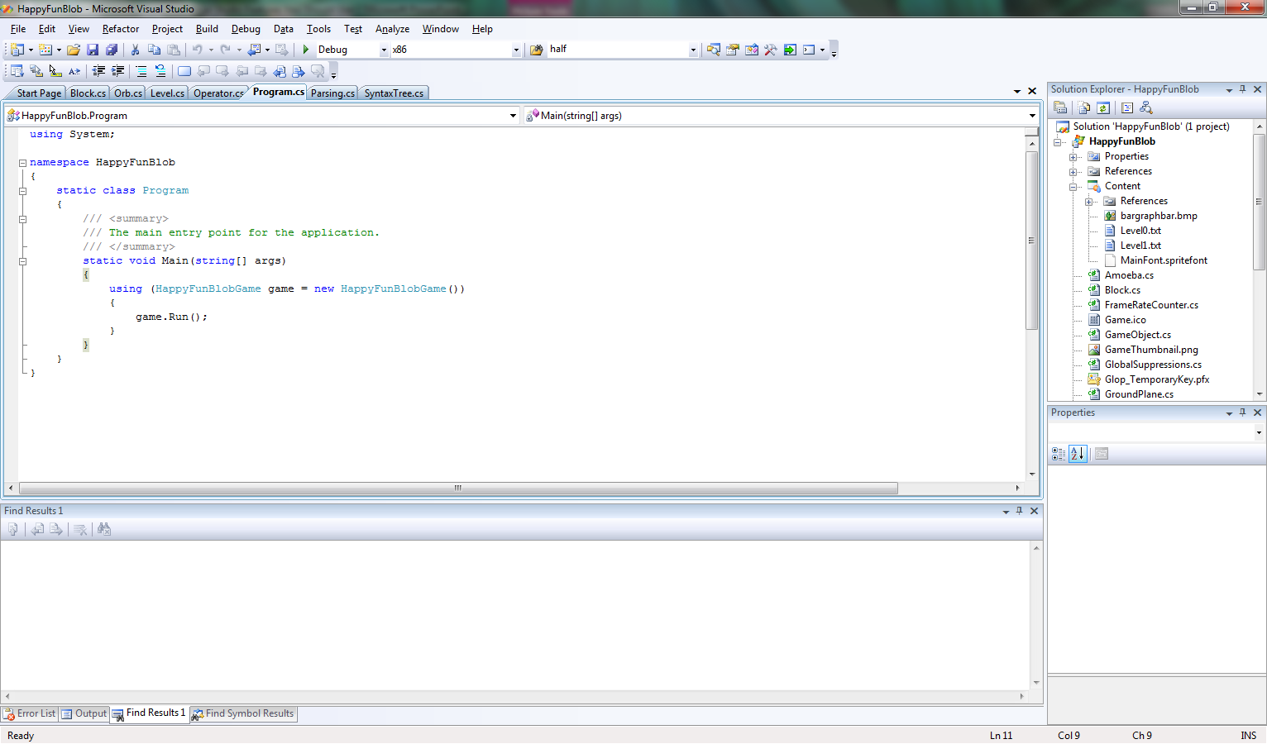
Screen layout while editing code
Files
Your code
Breakpoints
Compile errors and search results

Slide 4
Navigating code
Show next error (F8)
Brings you to the link where the next compilation error occurred
Find definition (F12)
Brings you to the definition of the name (variable, class, whatever) the cursor is currently on
Find all references (Shift-F12)
Shows you all the lines of code that use the name the cursor is presently on. Use F8 to step through them.
Find (Control-F)
Searches for a string in the current file
Find in files (Shift-Control-F)
Finds all occurrences of a string in all files of the project
Displays them at the bottom of the screen
Use F8 to step through them.

Slide 5
Changing code
Replace (Control-H)
Like find, but changes things
Replace in files (Shift-control-H)
Like find in files, but changes things
Rename (F2)
Let’s you change the name of the variable, class, or what have you the cursor is currently on
Also changes all the references to it
Rename is your friend!
There are also a lot of other great automagic code editing commands under the Refactor menu

Slide 6
Running code
Start program (F5)
Labeled “start debugging in the menu”
Or press the Play button
Stop debugging (Shift-F5)
Kills the program
Or press stop button
Run to cursor (F12)
Runs until the program gets to the line the cursor is one, then stops
Single-stepping
Step over (F10)
Executes the current line
Step over (F11)
Executes the current line, unless it has a procedure call, in which case it stops at the begging of the procedure
Step out
Runs to end of current procedure, then stops in the line that called it

Slide 7
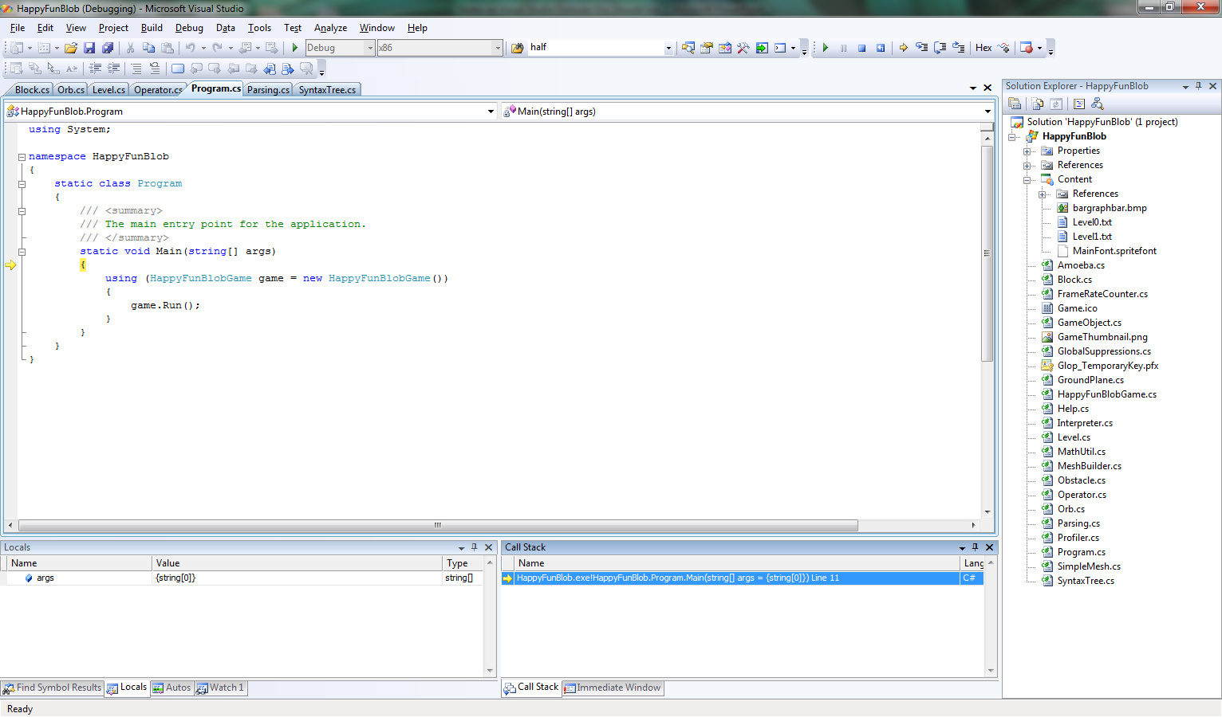
Screen layout when running code
Your code
Where the program is stopped
Variables
Stack

Slide 8
Inspecting the stack
Call Stack window
Shows all the procedures that are currently running
Double-clicking a procedure
Brings you to the line that its on
Shows the values of its local variables in the Locals and Autos window
Locals window
Shows the values of all local variables of the current procedure, including arguments
You can also mouse over a variable in the code to get its value
Autos window
Only show the values of the variables used in the current line (easier to navigate)

Slide 9
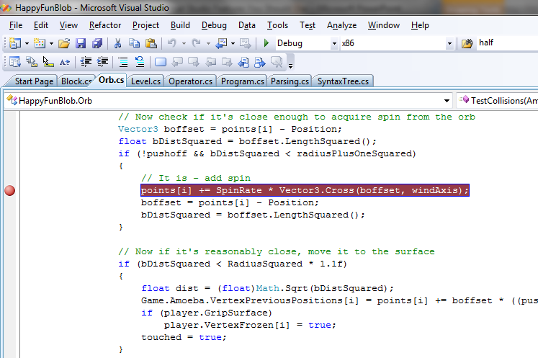
Breakpointing
Clicking on the left-hand margin of the code toggles (sets or removes) a breakpoint
You can also disable/reenable all breakpoints or remove all breakpoints, using entries in the Debug menu
Click here

Slide 10
Immediate mode
Lets you enter
Variable references
Field references
Procedure calls
And get their values interactively
It’s almost like having a dynamic language (Scheme, Python, Meta)
Immediate mode is only available while the program is running but paused (single step or breakpoint)
However, on a good day, you can also edit the code and recall it without having to explicitly stop the program and restart it

Slide 11
Outlining
Press + or – sign next to code to collapse or exapand
Control-M Control-O collapses whole file
#region and #endregion let you make named groups that you can collapse and expand

